Slide 1
Long Short Term Memory (LSTM)
By - Gaurav Kumar Yadav
May 23rd, 2020
3.00PM onwards

Slide 2
Agenda of today
Overview
Types of RNN (LSTM)
Understanding the problems with RNN
One to one lstm
One to many lstm
Many to many lstm
Many to one lstm
LSTM Objective
Features of LSTM
Implementation on Jupyter notebook

Slide 3
Overview
Why Recurrent Neural Network?
To learn the sequential data like Video, audio, paragraph writing, music generation, sentiment analysis, language translation from one medium to another medium(google translator).
ANN output does not depend on the previous output, so it is unable to predict correctly to those data where current output is highly dependent on sequence of previous output.
Number of input and output unit can not varies during the testing phase, means if you build a model which take 10 input feature and predict the output as two 0 and 1 (just example), then the output size should not varies during the test time whereas in RNN (LSTM) it can varies.

Slide 4
Understanding the problems
If RNN were there then why LSTM
01
During the backpropagation through time due to chain rule of multiplication of the gradient there is high probability that after some multiplication the loss gradient will become either very small , vanish, or very big , explode.
02
The case when gradient explode from certain limit, it will also affect in weight updation of starting layers neuran compare to last layer neurons. To counter this problem we use concept of gradient clipping. Where we set a limit, when gradient will cross that limit we clip then or normalize them
03
The most important problem which occur generally because the output of the activation function varies between 0 and 1 or -1 to 1. There is a huge probability that after some multiplication gradient will reach nearer to zero, and vanish the effect of updation in start layer of neurons weights. This is called Vanishing Gradient Problem.

Slide 5
LSTM objective
To counter or finish the problem of vanishing gradient we use Long short term memory concept. In which we gate concept to remember the dependencies of the previous layer in the sequence.
It uses additive concept instead of multiplication in chain rule.

Slide 6
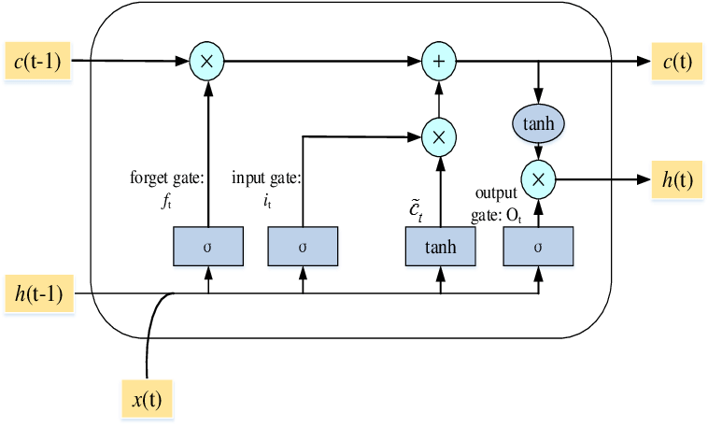
Structure of LSTM

Slide 7
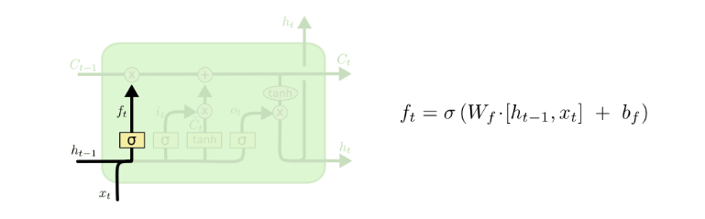
Forget gate

Slide 8
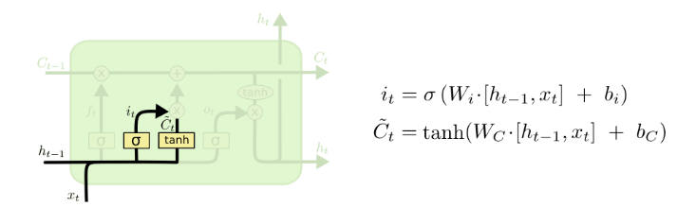
Input gate and memory cell

Slide 9
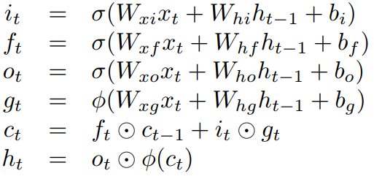
Whole parameters used in LSTM

Slide 10
Types of RNN
Now a days Four types of RNN (LSTM) we are using
1- ONE TO ONE → one input one output (less commonly use)
2- ONE TO MANY → Music generation
3- MANY TO ONE → Sentiment analysis (Movie rating)
4- MANY TO MANY → Machine translation , Name entity

Slide 11
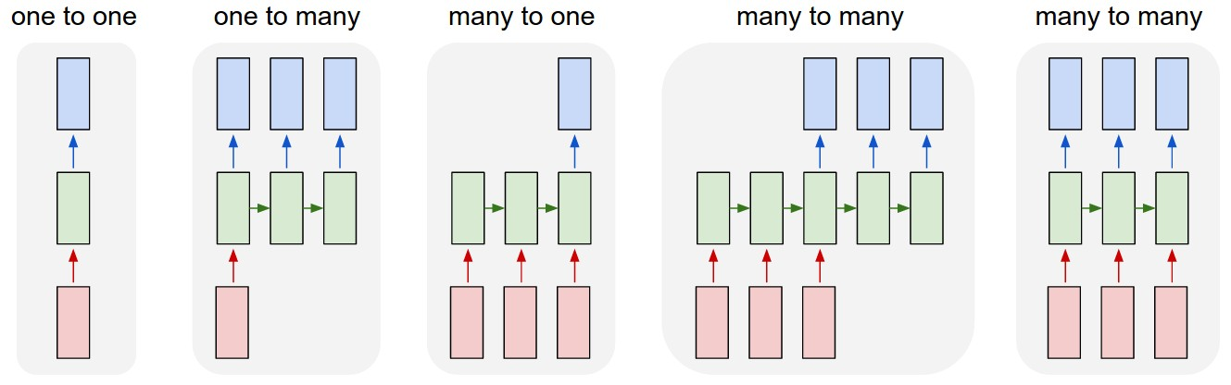
Types of RNN

Slide 12
Various types of LSTM
1- Vanilla LSTM
2- Stacked LSTM
3- Bidirectional LSTM
4- CNN LSTM 5- ConvLSTM
For details you can go through reference -2

Slide 13
Implementation of LSTM using keras API on google colab
https://github.com/gaurav-vision/Recurrent-Neural-Network

Slide 14
References
1- https://colah.github.io/posts/2015-08-Understanding-LSTMs/
2-https://machinelearningmastery.com/how-to-develop-lstm-models-for-time-series-forecasting/
3- https://www.bioinf.jku.at/publications/older/2604.pdf

Slide 15
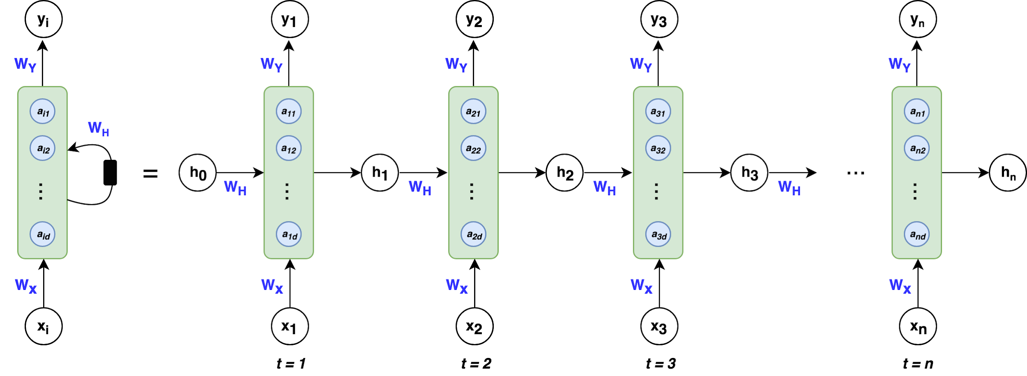
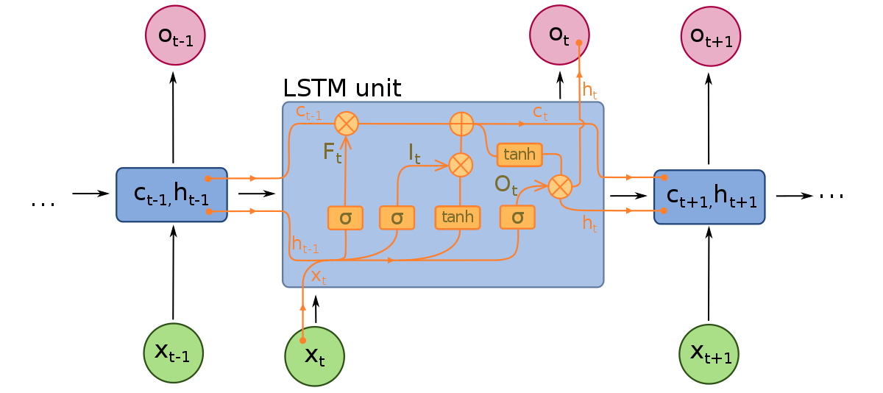
Thank you!

